Slide 1
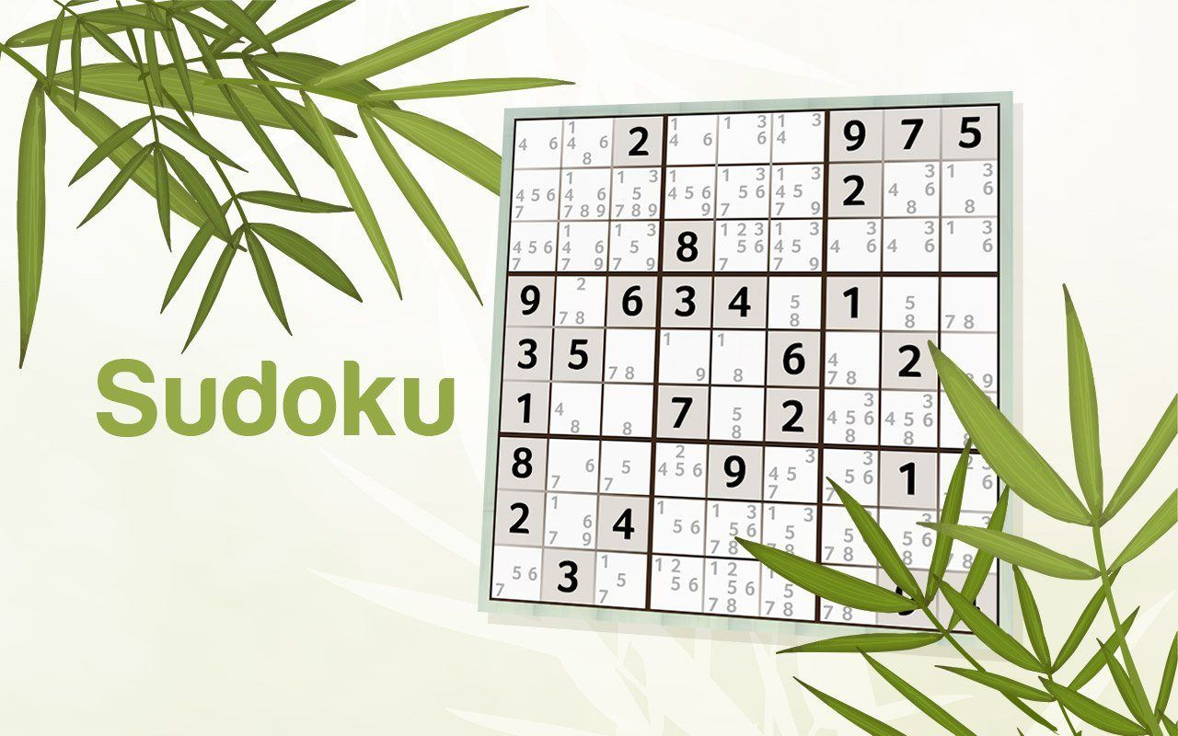

Slide 2
Project Introduction
Sudoku Solver
This project is about to solving a Sudoku problem by a particular method which given a correct solution for given problem.
We work very hard to complete this project and able to build logic that can find out the solution of Sudoku problem and it generate solution for some multiple grids
Key Feature
Adjusting Gameplay mood.
II. Giving a unique solution.
III. Editing given input for updating input.
IV. Error solving

Slide 3
What is Sudoku?
Sudoku requires no calculation or arithmetic skills .
> It is essentially a game of placing numbers in squares, using very simple rules of logic and deduction.
> It can be played by children and adults and the rules are simple to learn
> Sudoku is a puzzle game designed for a single player, much like a cross word puzzle.
>The puzzle itself is nothing more than a grid of little boxes called "cells".

Slide 4
Work Description
Concept
The main concept of our project is solving Sudoku by our software/code. Our software/code can solve any Sudoku of 4*4/66/99. Sudoku is a popular game and our code make this game more easy and interesting.
Idea
We got the idea of making the software/code from the famous Sudoku game (It shows the solve of the Sudoku problem
Logic
Sudoku is a popular game. We know the basic rules of Sudoku. Logic of our software code make by using possibility, combination, permutation. Logic calculate row and column possible solution wild Logic use different combination of grid for different dimension of Sudoku. Every dimension a fived grid and logic calculate the possible solution by using grid. We have used 2*2 dimension for 4 grid sudoku.

Slide 5
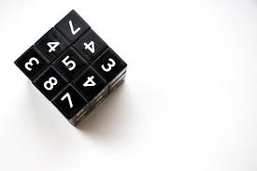
Objective of Sudoku
Every Sudoku games begins with a number of squares already filled in and the difficulty of each game is largely a function of how many squares are filled in.
The more squares that are known, the easier it is to figure out which numbers go in the open squares. As you fill in squares correctly, options for the remaining squares are narrowed and it becomes easier to fill them in.
Sudoku's are usually categorised as easy, medium or hard.

Slide 6
Objective of Sudoku
The objective of the game is to fill all the blank squares in a game with the correct numbers. There are three very simple way to follow. In a 9 by 9 square Sudoku game:
Every row of 9 numbers must include all digits 1 through 9 in any order
Every column of 9 numbers must include all digits 1 through 9 in any order
Every 3 by 3 subsection of the 9 by 9 square must include all digits 1 through 9.
Similarly, smaller Sudoku puzzles, such as the 4x4 puzzle, must have the numerals I through 4 in each row, column and subsection.
Medium Sudoku puzzles, such as 6x6 puzzle, must have the numerals I through 6 in each row column and subsection .
The principles are the same whatever the size of the game.

Slide 7
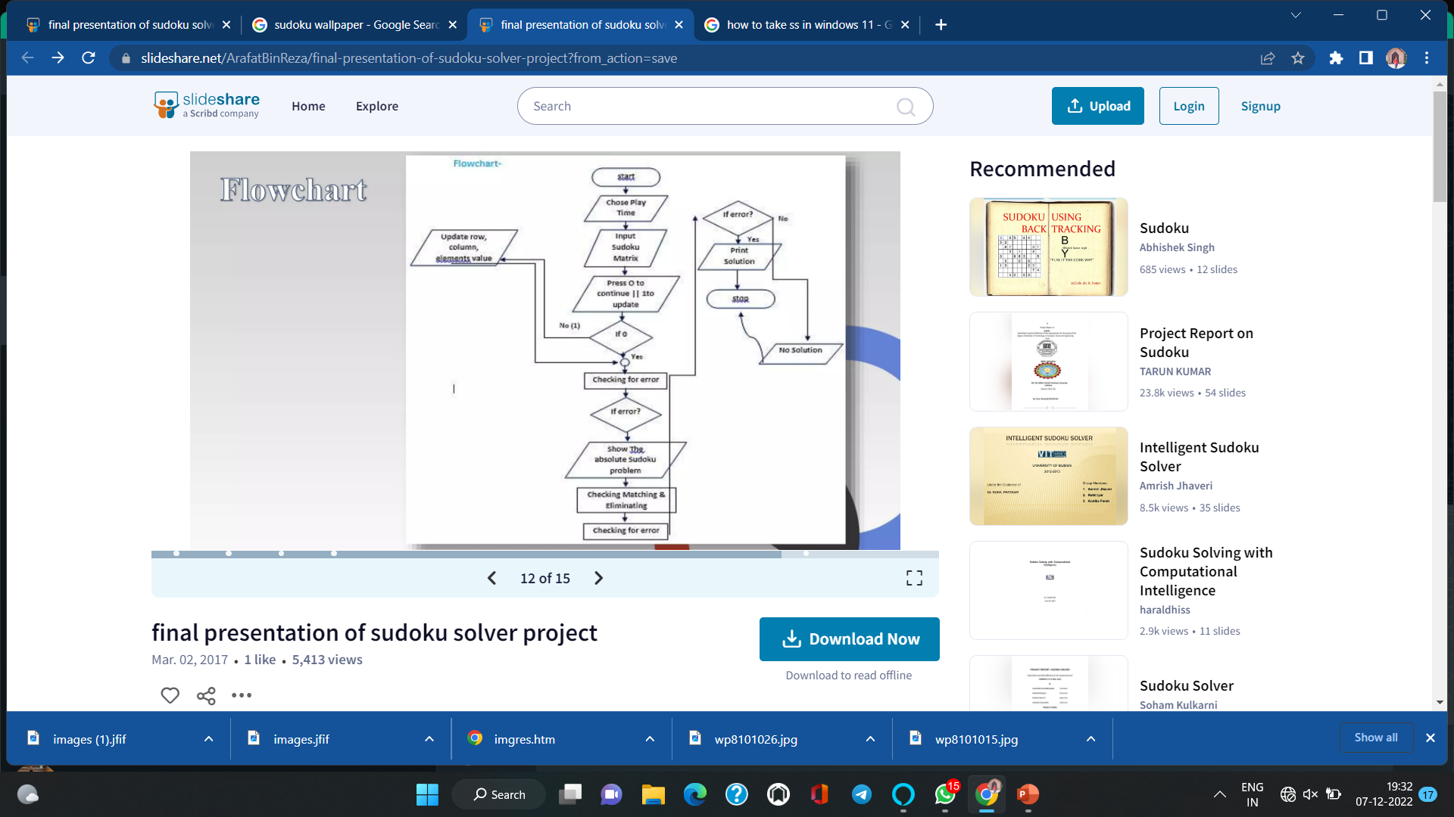
FLOW
CHART

Slide 8
Algorithm
Step1. Start
Step2. Enter how many time you want to play
Step3. Chose gameplay mood.
Step4. Enter matrix of Sudoku problem
Step5. Press 0 to continue Or 1 to update
Step6. If 0 then
Continue
Else update: row, column, replacing element value and exit
Step7. Checking for error
Steps8. If error then
update row, column, replacing element value and to exit.
Else: continue
Step9. Print the absolute Sudoku problem
Step10. Processed by checking, pattern matching and elimination
Step11. Checking for error
Step12. If error then :
Print "no solution“,
"Else” Print solution Sudoku
Step13. Stop

Slide 9
Conclusion
The algorithm seems to be a useful method to solve any Sudoku puzzles and it can guarantee to find at least one solution. However, this algorithm is not efficient because the level of difficulties is irrelevant to the algorithm. In other words, the algorithm does not adopt intelligent strategies to solve the puzzles. This algorithm checks all possible solutions to the puzzle until a valid solution is found which is a time consuming procedure resulting an inefficient solver. As it has already stated the main advantage of using the algorithms the ability to solve any puzzles and a solution is certainly guaranteed.

Slide 10


